Slide 1
The Beginners Guide to Simple Game Making

Slide 2
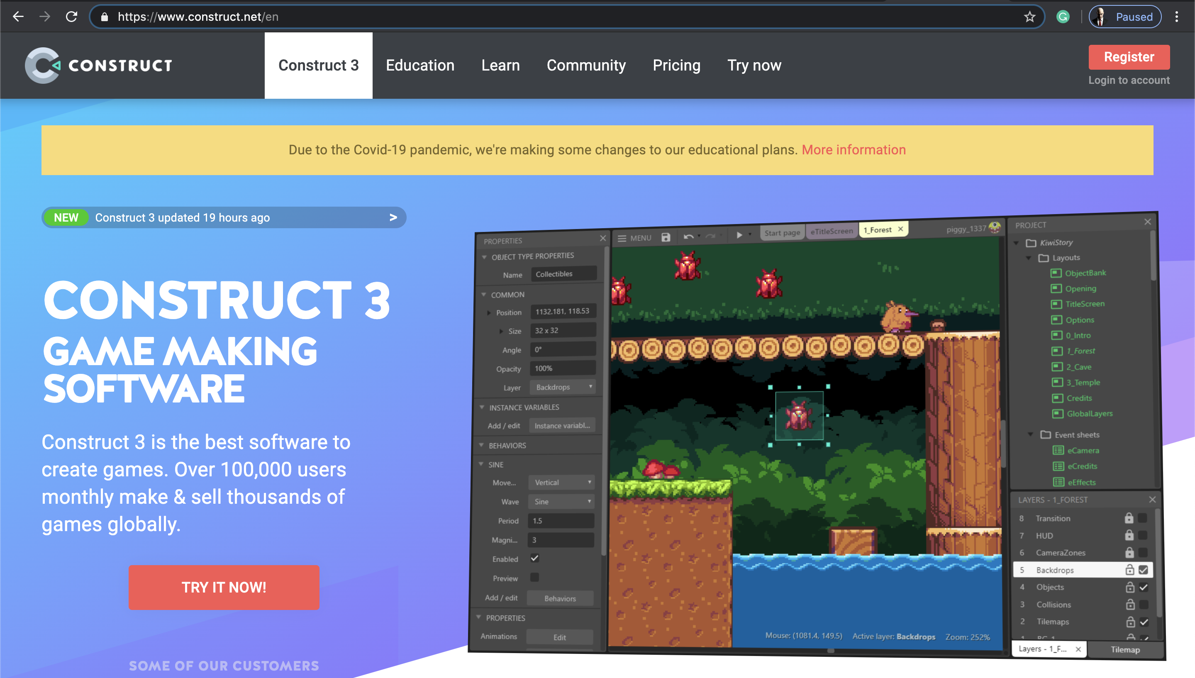
Welcome to the Beginners Guide to Construct 3
'Your first task is to follow this link https://www.construct.net/en'
And then register yourself a brand-new
account here.
(It is absolutely free to join )

Slide 7
Your crosshair will look something like this

