Slide 1
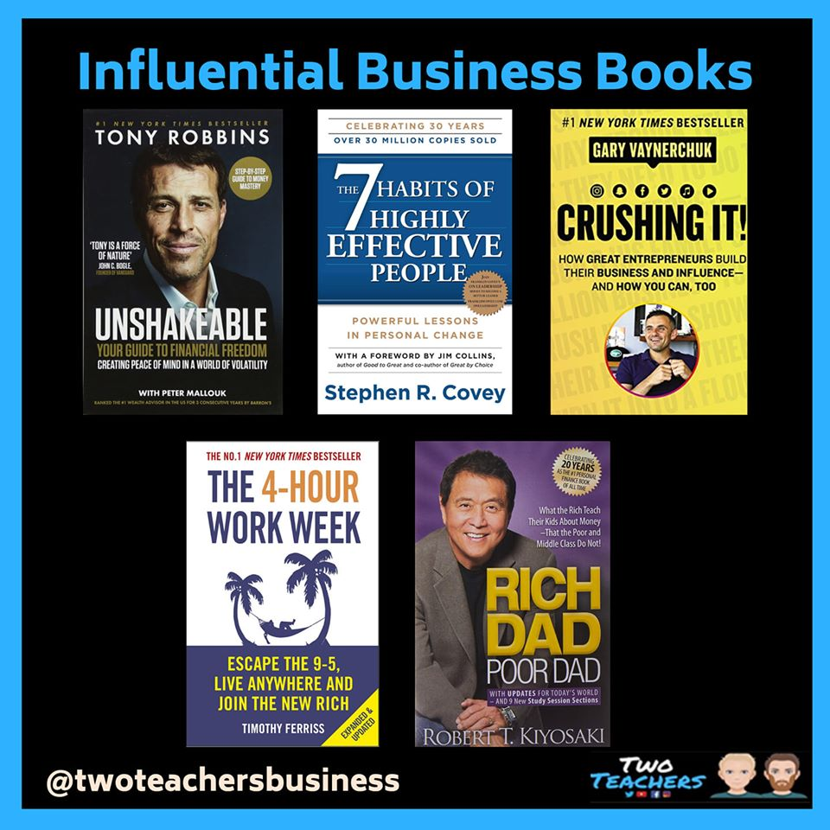

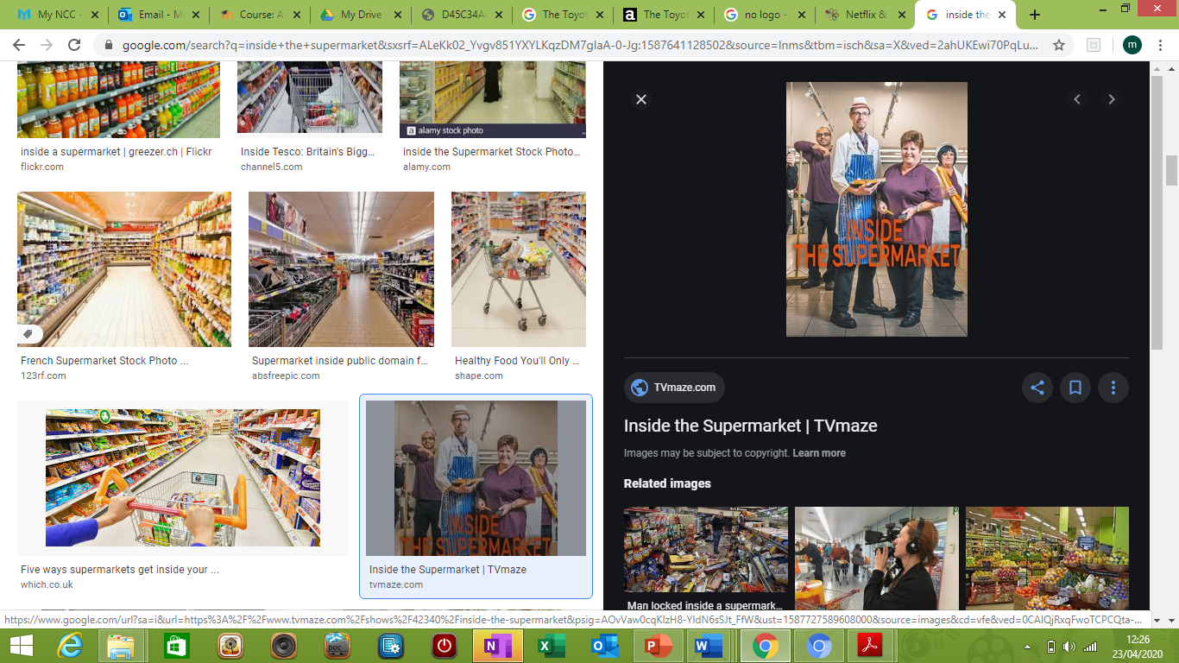
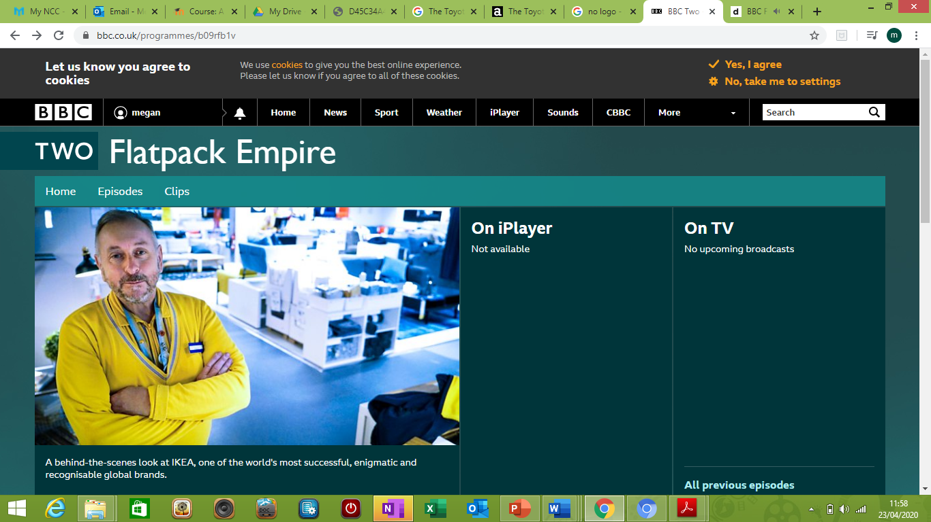

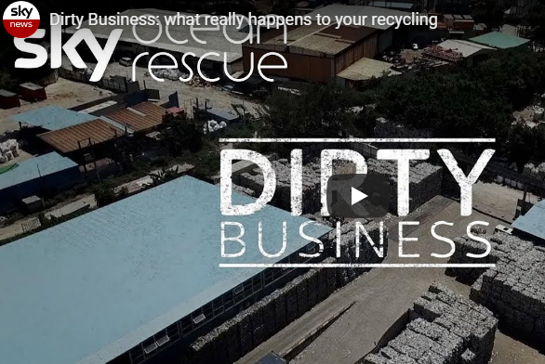
BTEC Business
Getting Ready
BTEC Business
Topics
Finance
Marketing
Human Resources
Exam Board
Pearson
Recommended Reading
https://www.bbc.co.uk/news/business
https://www.theguardian.com/uk/business
https://www.cnbc.com/world/?region=world
https://news.sky.com/business
https://www.youtube.com/user/cnbc
https://www.bloomberg.com/europe
Keep on top of business news and current affairs
Start watching business documentaries/films
Inside the supermarket
Flatpack Empire- IKEA
Dirty Business – Recycling
https://www.eu-startups.com/2020/03/netflix-documentaries-every-entrepreneur-should-see/

Slide 2




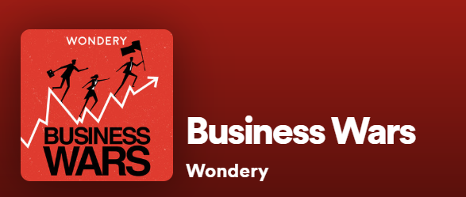
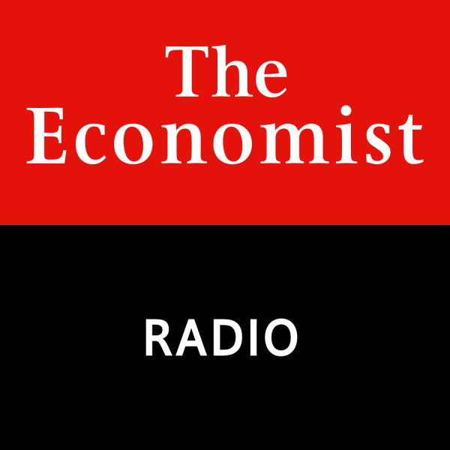
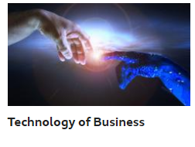
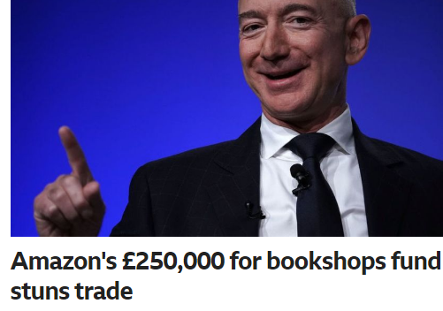



Get listening to business related podcasts
https://www.ted.com/talks/simon_sinek_how_great_leaders_inspire_action
https://www.economist.com/podcasts/
https://wondery.com/shows/business-wars/
Get on social media and follow/like a business related news feed. Search for BBCBusiness, Tutor2u, SkyNewsBiz, TheEconomist
Conduct a study
    Task 1: What does SWOT stand for?
    Explain what SWOT stands for – use Tutor2u for research.
    Task 2: Undertake a SWOT analysis of Greggs. Remember that S & W are internal i.e. things they have control over. O & T are external i.e. outside Greggs control. Read the article on Greggs to help you with this: https://www.managementtoday.co.uk/why-greggs-roll/leadership-lessons/article/1667566?fbclid=IwAR0p-hWxxsqxpfDU5dKS7bZeIMI2I-10D0W-qPWOcfL9INcmt8TyXk8HPG0
Task 3: Find the definitions for the following concepts and create a glossary of key terms:
    Market share
    Stakeholders
    Motivation
    Competitive
    advantage
    Cash flow
    Supply Chain
    Multinational
    Trade Bloc
Task 4: Read the article https://www.bbc.com/news/uk-england-49433347and answer the questions
1) Give some examples of stakeholders in this situation.
2) What influence do these stakeholders have?
3) Provide three positives and three negatives to a McDonald’s being built in Rutland.
4) Has McDonald’s encountered a similar situation before? What was the result?
5) What is the demographic in Rutland? How does this affect this process?
6) Do you think McDonald’s will be successful?
We Look forward to meeting you!

